Slide 1
Capstone Application
July, 2024

Slide 2
Introduction
Title: Introduction Content:
Overview: This presentation covers the Contact Management Application built with React, Spring Boot, and MySQL.
Purpose: To provide a seamless solution for managing contact information through Create, Read, Update, and Delete (CRUD) operations.

Slide 3
Technology Stack
Frontend: React
Benefits: Component-based architecture, Virtual DOM for performance, rich ecosystem.
Backend: Spring Boot
Benefits: Rapid development, built-in security, and integration capabilities.
Database: MySQL
Benefits: Structured data storage, scalability, and reliability.

Slide 4
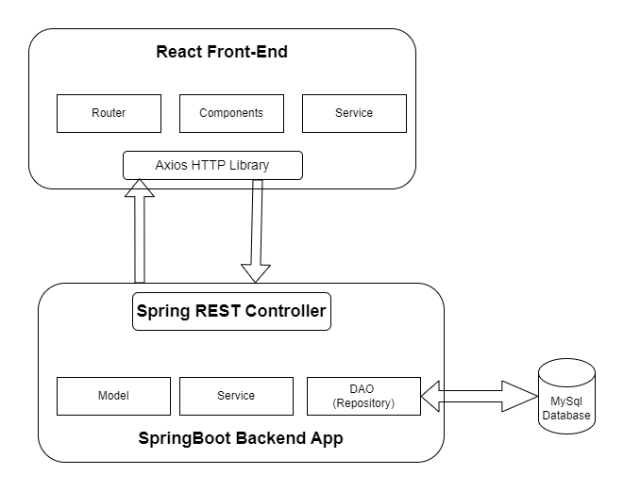
Technology and Architecture : Framework

Slide 5
CRUD Operation
Create: Users can add new contacts via a form.
Read: Displays a list of contacts with the ability to view details.
Update: Allows modification of existing contact information.
Delete: Provides functionality to remove contacts.
Search: Search a contact by name.

Slide 6
API Endpoints
API Endpoints:
GET api/contacts: Retrieve a list of contacts.
GET /{name}: Retrieve a specific contact by name.
POST /api/contacts: Create a new contact.
PUT /api/contacts/{id}: Update an existing contact by id.
DELETE /api/contacts/{id}: Delete a contact by id.

Slide 7
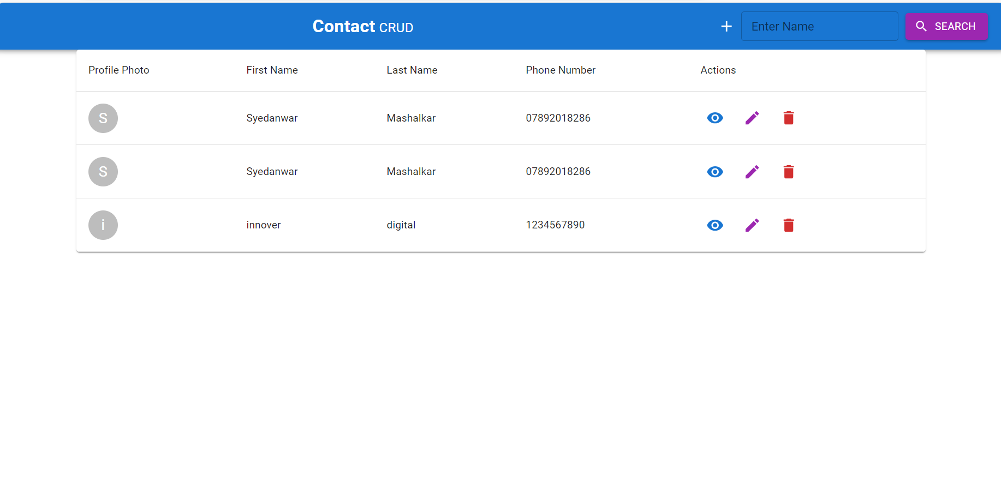
View Operation

Slide 8
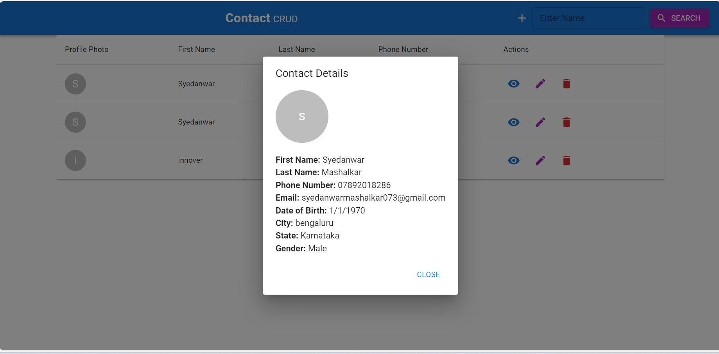
View All details of Person

Slide 9
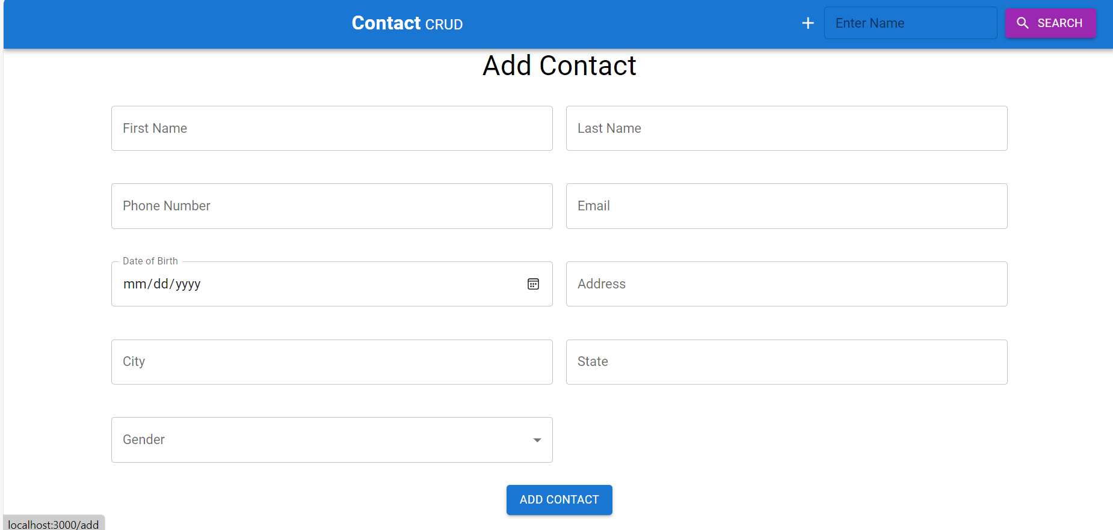
Form to Add person

Slide 10
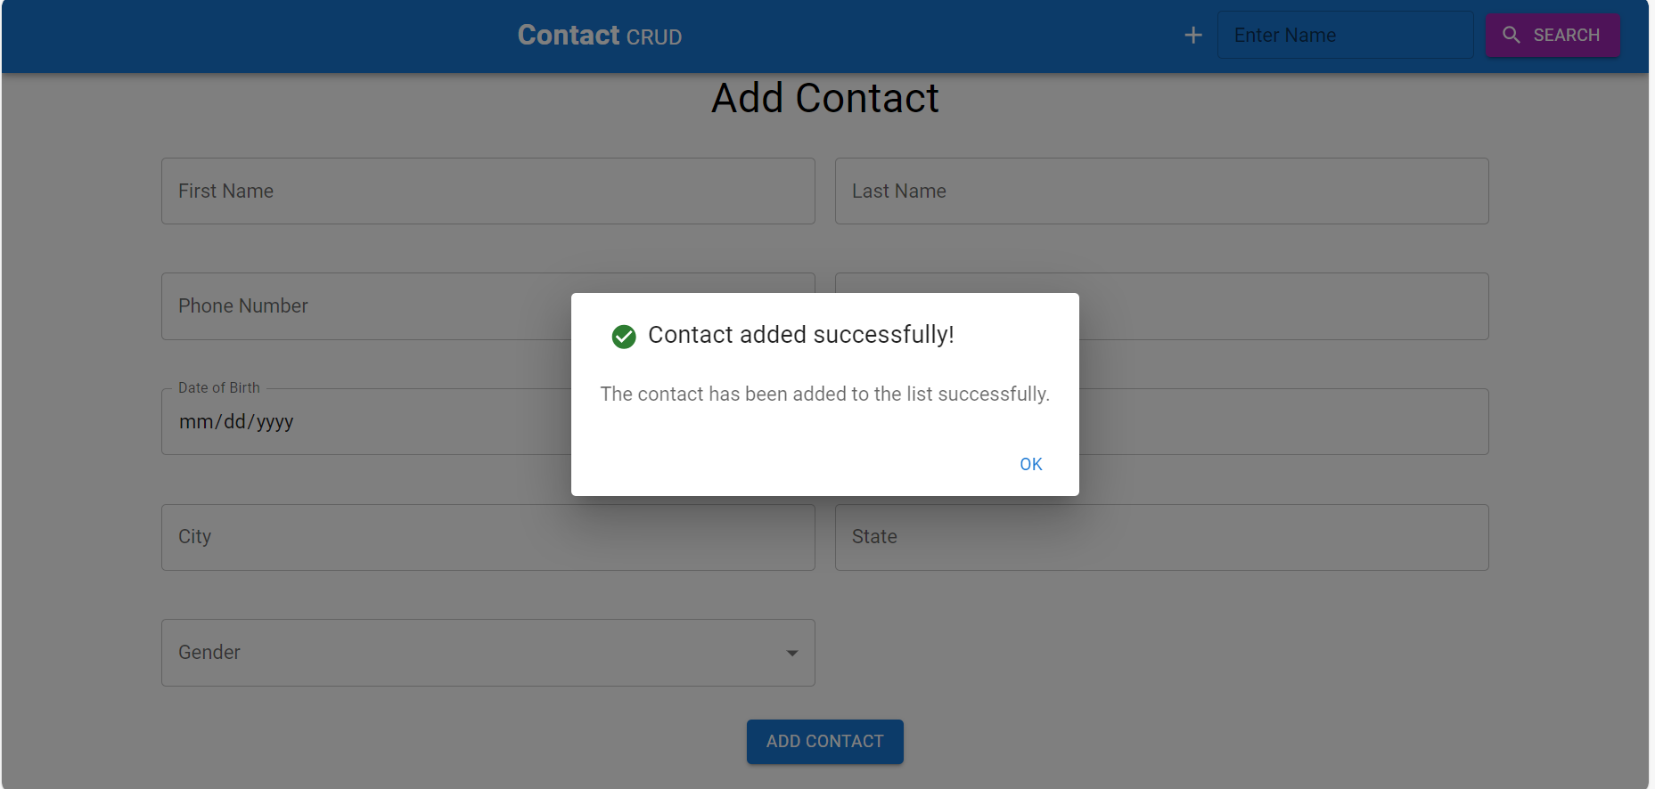
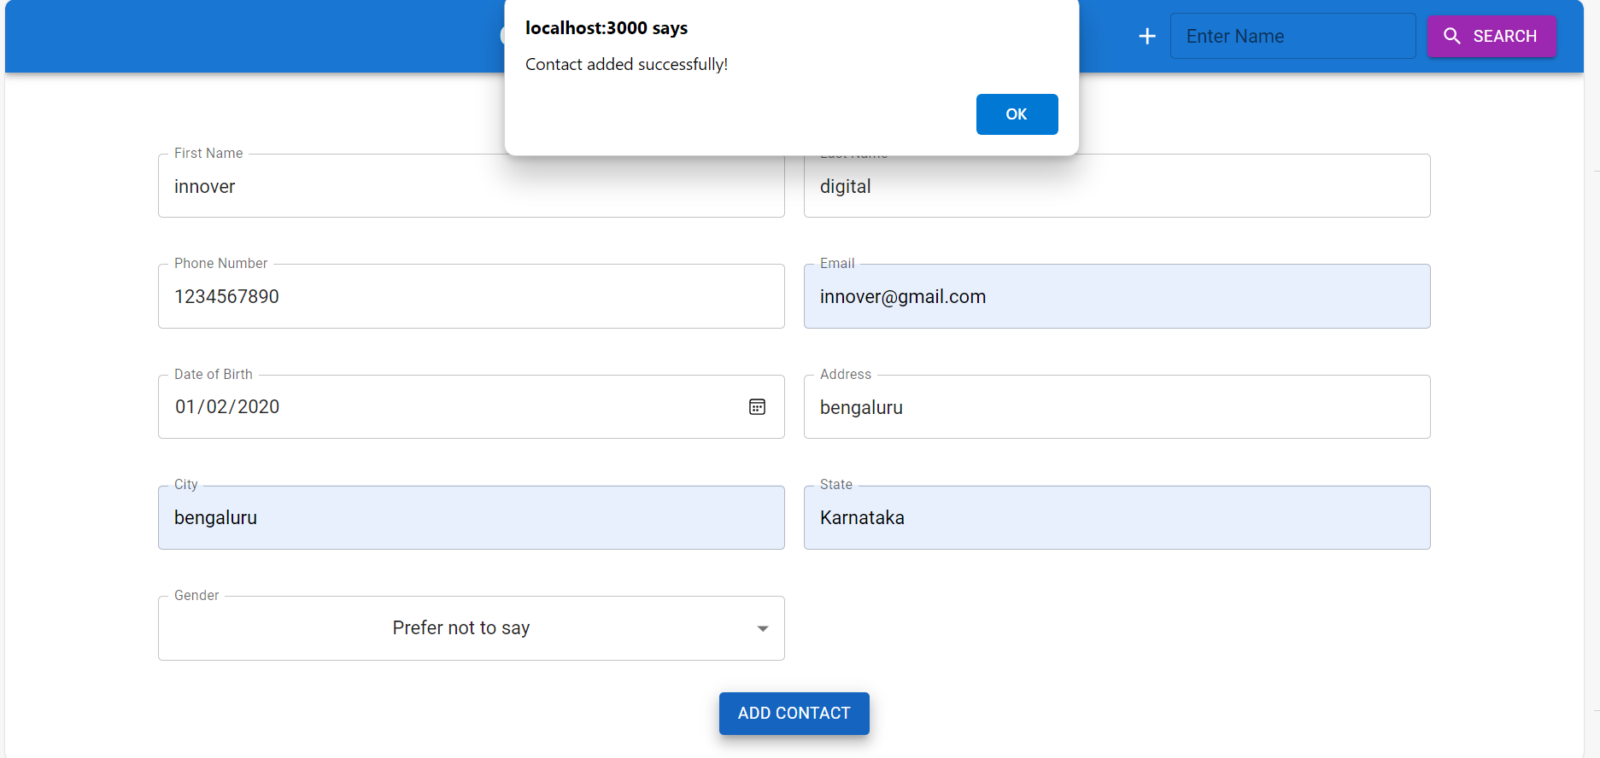
Screenshots
Add Operation

Slide 11
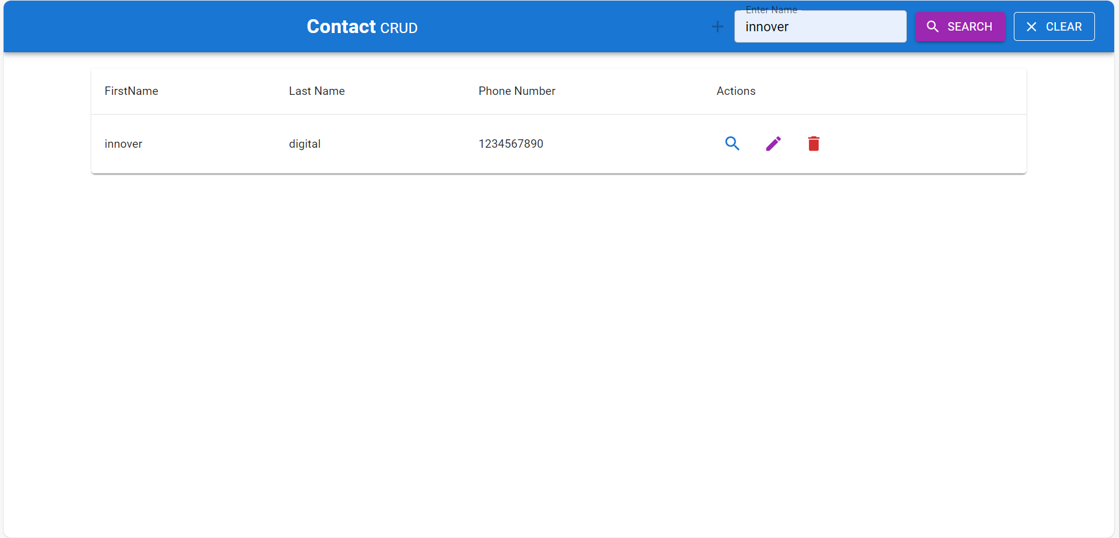
Search By name
Search Operation

Slide 12
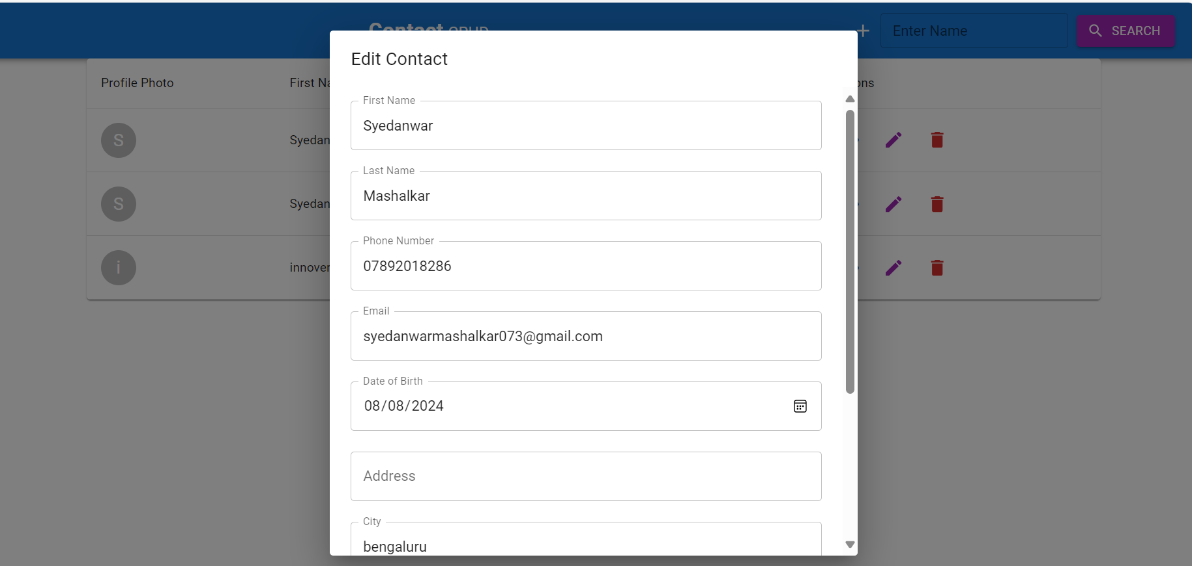
update an existing record

Slide 13
.
Thank You !!

